Slide 1
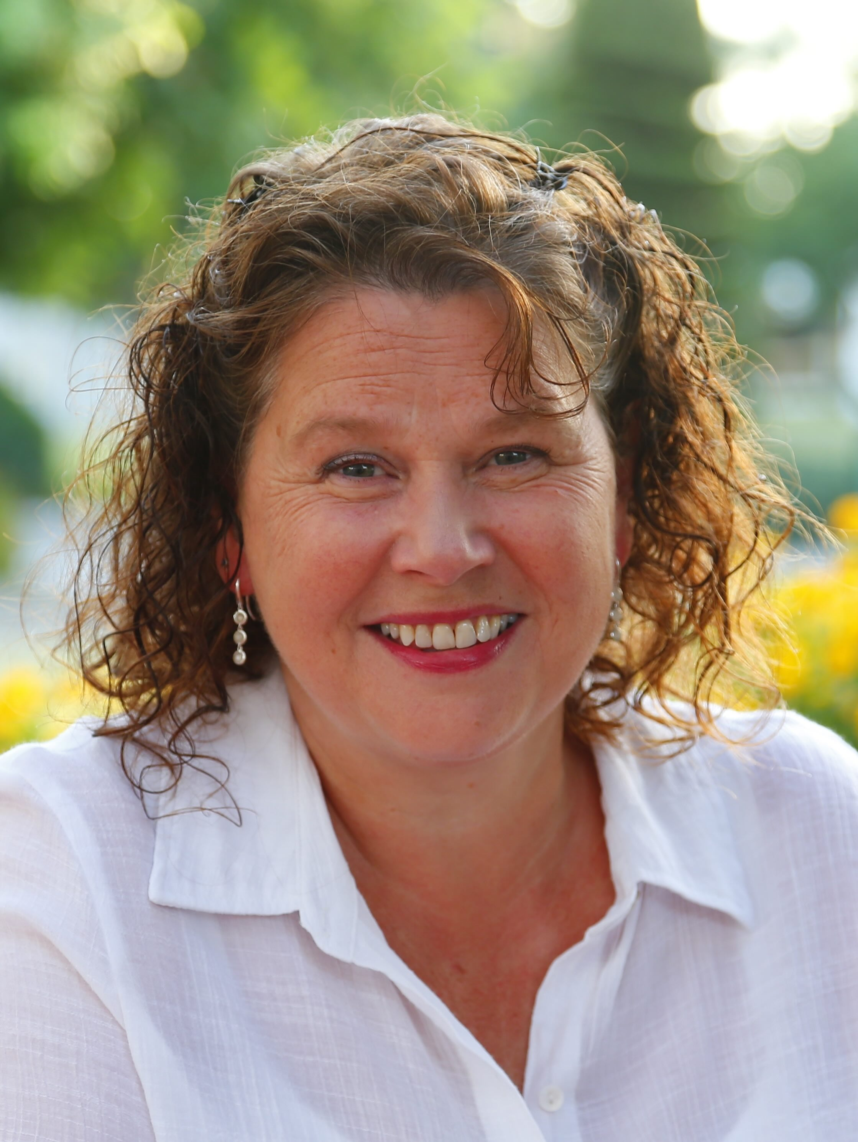
Rachael Wallace-Lane
Training, Facilitation & Coaching
With over 21 years of experience, I am a seasoned professional in training, facilitation, and coaching. I have delivered programs virtually in 15 countries, across all sectors, comfortably engaging with everyone from board-level executives and leadership teams to front-line staff and young people.
In my Leadership roles I enjoyed co-creating Learning and Development and Culture Change, programmes. Embedding organisational values, creating consistency and transparency throughout the organisation, encouraging system change and positive disruption.
My client portfolio spans independent traders to global organizations, including PwC, Microsoft, NHS, HMRC, and KPMG.
Delivering in-person and virtual sessions, in Zoom and on Teams I enjoy working alongside
clients to tailoring bespoke content to meet specific client needs.
Specialising in:
Leadership, Management Fundamentals, and Soft Skills
Values, Vision, and Strategic Planning
Neurodiversity and Disability Awareness
Coaching Culture and Conflict Resolution
Location: Based in Edinburgh, Scotland, happy to travel. Availability: Monday – Friday
“ I highly recommend Rachael as a trainer. She listens to her clients’ needs and expectations and works with them to tailor her training to achieve the outcomes expected”.

Slide 2
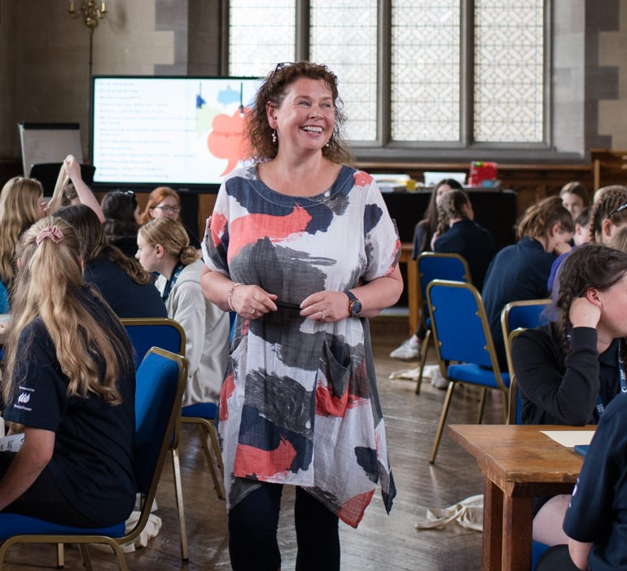
Rachael Wallace-Lane
“My purpose is to live a life that embodies my values:
Boldness, Curiosity, Transparency and Compassion”
EDUCATION
Professional Certified Coach
Graduate of The Coach Approach
Teaching Skills with The Mindfulness Association
Mentoring Training, Diploma in Management
AEB Certificate in Counselling, Skills
LEARNING AND DEVELOPMENT
Enhanced Performance Strategies
for Neuro-Differences in the Work-Place
Understanding Neurodiversity
Facilitative Trainer and Manager, Train the Trainer
“Rachael spends time to get to know what you and your organisation are all about so that she can deliver training that is relevant and useful to you. She organises herself and the training well and always delivers professionally and with knowledge of the subject matter. Always reliable I have no hesitation in recommending Rachael”.
“Rachael brilliantly facilitated staff-wide training around culture change, management fundamentals, project planning - this is a woman who loves a logic model! - and measuring and evaluation. I'd recommend Rachael for similar work in a heartbeat”.
RATES:
£160 per hour, there is always space to flex depending on length of projects, so please reach out to chat through.
Email: info@rachaelwallacelane.com Phone: 07770299560
Linked In: Rachael Wallace-Lane Website: rachaelwallacelane.com

